Slide 1
DeepFake
Submitted by
Thlibi Mohamed Ali
2023/2024

Slide 2
Types of DeepFake
Face swap
Audio deep fakes
Lip-syncing
Face synthesis and attribute manipulation
Puppet-mastery
1

Slide 3
Applications of deepfake
Education | Entertainment | Art | Accessibility | Fraud | Social media
A teacher may use deep fakes to help give more interesting lectures | Film and gaming industries utilize deepfakes technology to recreate and modulate actors' voices for specific sequences | Deepfake can make pricey VFX techniques more accessible. For a small fraction of the price, it may also develop into a potent tool. | Artificial intelligence can create tools that can hear, see, and, soon, reason with increasing accuracy | Deepfakes are used to impersonate an individual to obtain personally identifiable information (PII), such as bank account and credit card numbers | One can use deepfake innovation in conjunction with creating stories or blogs to build a fake internet profile
2

Slide 4
Faceswap
Ffmpeg - Output the swap to a video file
Pillow - Output the swap to a series of images (more format support than OpenCV, but slower)
The writers
Gif - Create an animated GIF from the swap
OpenCV - Output the swap to a series of images.
3

Slide 5
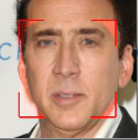
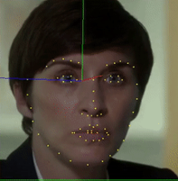
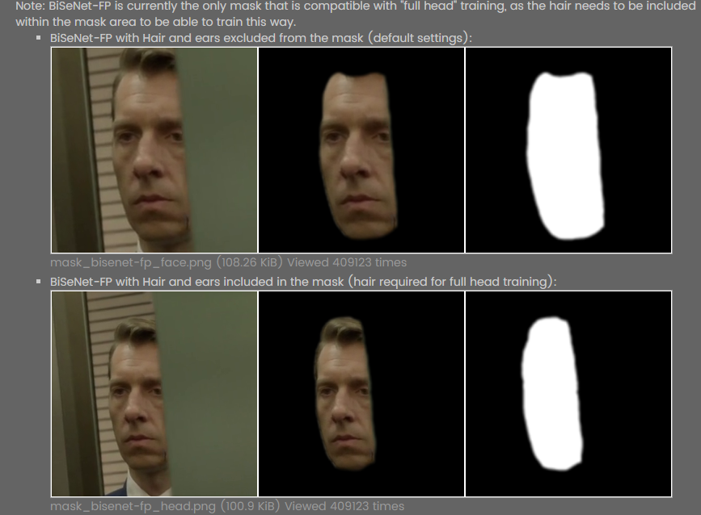
Extraction
Detection - The process of finding faces within a frame. The detector scans an image and selects areas of the image that it thinks are faces.
Alignment - Finding the "landmarks" (explained later) within a face and orienting the faces consistently.
Mask Generation - Identify the parts of an aligned face that contains face and block out those areas that contain background/obstructions.
4

Slide 6
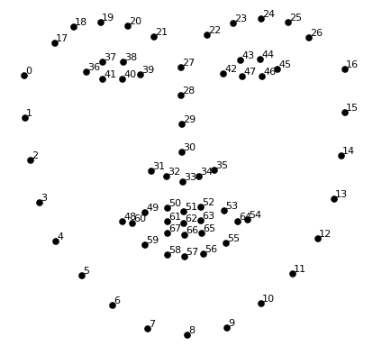
The Alignments File
The alignments file specifically holds the following information :
The location of each face in each frame
The 68 point landmarks of each face in each frame
The "components" and "extended" mask for each frame
Any other user generated masks
A small jpg thumbnail of the aligned face (used for the manual tool)
5

Slide 7
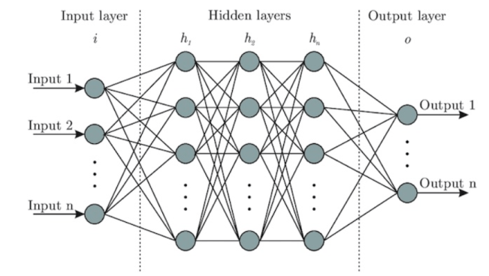
Image processing using Neural Networks
Neural Networks are multi-layered networks consisting of neurons or nodes. These neurons are the core processing units of the neural network. They are designed to act like human brains. They take in data, train themselves to recognize the patterns in the data and then predict the output.
A basic neural network has three layers:
Input layer
Hidden layer
Output layer
6

Slide 8
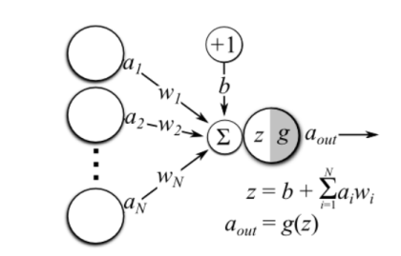
In the below image, ai’s is the set of inputs, wi’s are the weights, z is the output and g is any activation function.
Here are some guidelines to prepare data for image processing.
More data needs to be fed to the model to get the better results.
Image dataset should be of high quality to get more clear information, but to process them you may require deeper neural networks.
In many cases RGB images are converted to grayscale before feeding them into a neural network.
7

Slide 9
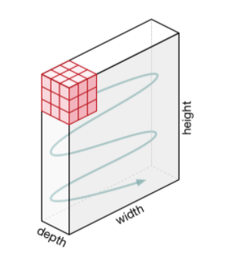
Convolutional Neural Network
A convolutional neural network, ConvNets in short has three layers:
Convolutional Layer (CONV): They are the core building block of CNN, it is responsible for performing convolution operation.The element involved in carrying out the convolution operation in this layer is called the Kernel/Filter (matrix). The kernel makes horizontal and vertical shifts based on the stride rate until the full image is traversed.
8

Slide 10
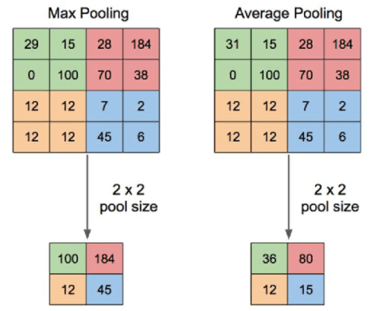
Pooling Layer (POOL): This layer is responsible for dimensionality reduction. It helps to decrease the computational power required to process the data. There are two types of Pooling: Max Pooling and Average Pooling. Max pooling returns the maximum value from the area covered by the kernel on the image. Average pooling returns the average of all the values in the part of the image covered by the kernel.
9

Slide 11
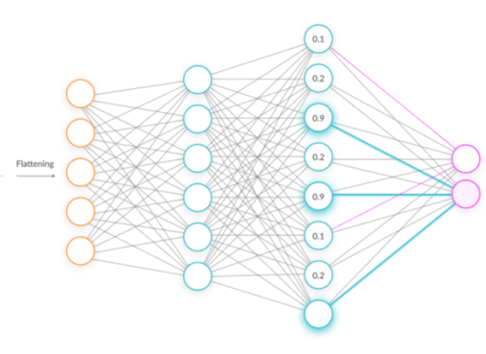
Fully Connected Layer (FC): The fully connected layer (FC) operates on a flattened input where each input is connected to all neurons. If present, FC layers are usually found towards the end of CNN architectures.
10

Slide 12
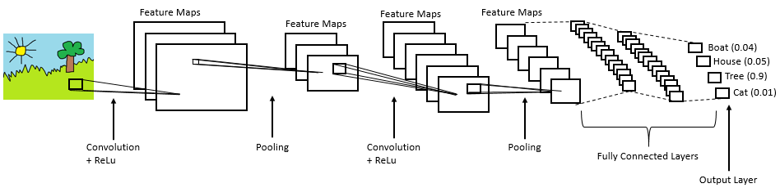
CNN is mainly used in extracting features from the image with help of its layers. CNNs are widely used in image classification where each input image is passed through the series of layers to get a probabilistic value between 0 and 1.
11

Slide 13
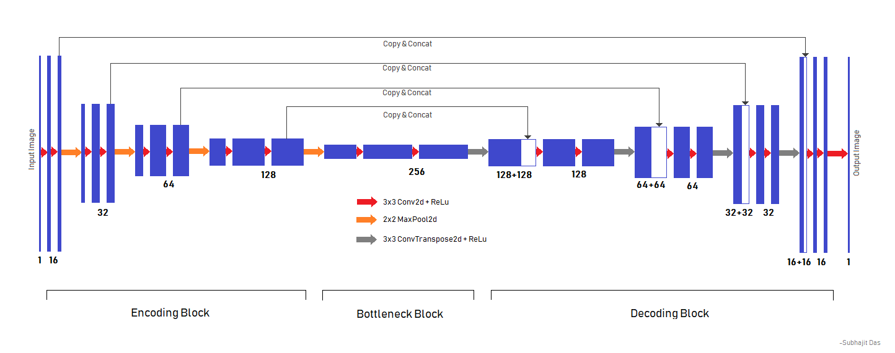
Deepfake training
Training is teaching our Neural Network (NN) how to recreate a face. Most of the models are largely made up of 2 parts (Encoder , Decoder )
12

Slide 14
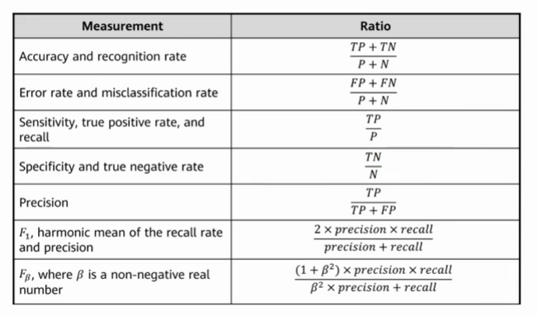
Performance Metrics
Classification applications use four main outputs to generate data :
True positive : the ground truth is positive and the predicted category is also positive
False positive : the ground truth is negative and the predicted category is positive
True negative : the ground truth is negative and the predicted category is negative
False negative : the ground truth is positive and the predicted category is negative
13

Slide 15
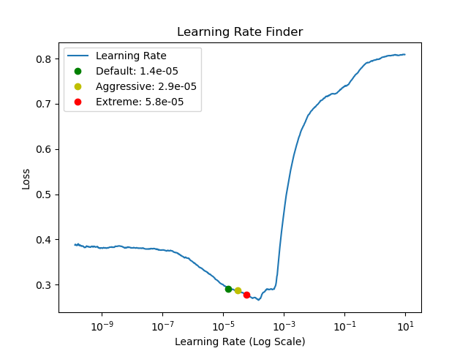
Loss
14

Slide 16
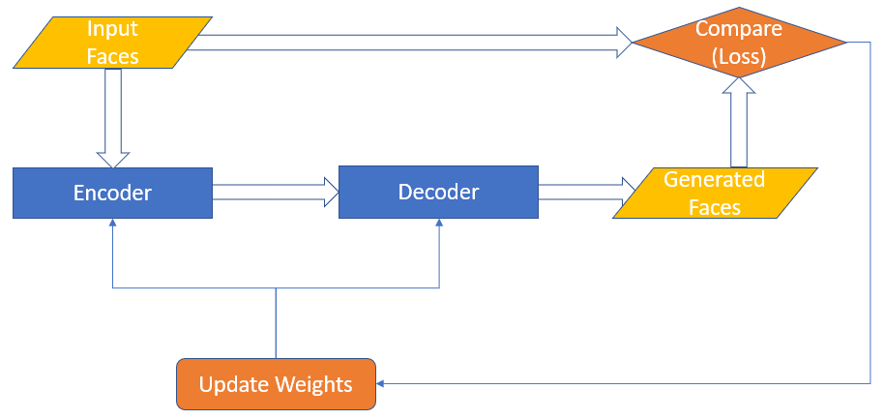
Weights
15

Slide 17
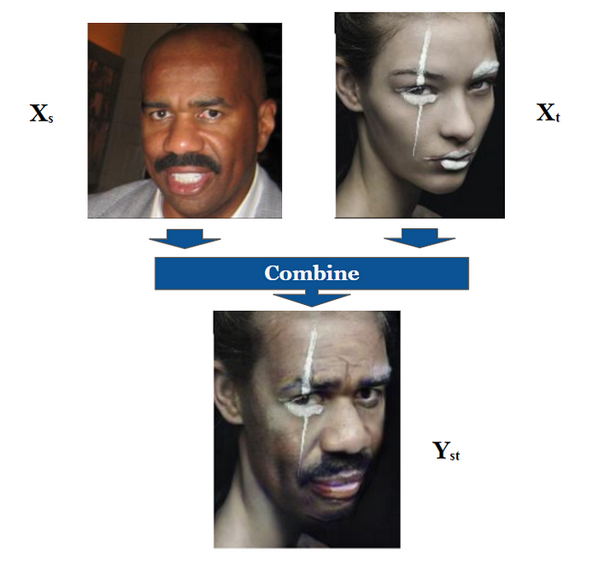
The FaceShifter Model
FaceShifter is comprised of two networks called AEI-Net & HEAR-Net. AEI-Net produces a preliminary face-swapping result, and HEAR-Net refines this output.
16

Slide 18
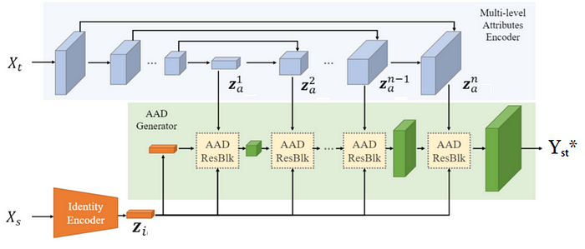
AEI-Net
AEI-Net is an acronym for “Adaptive Embedding Integration Network”. This is because AEI-Net consists of 3 sub-networks (Identity encoder , Multi-level attributes encoder , AAD Generator )
17

Slide 19
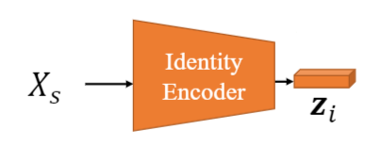
Identity Encoder
This vector encodes the identity of the face in Xₛ which means that it should extract features we humans use to differentiate between the faces of different persons like the shape of their eyes, the distance between the eyes and the mouth, the curvature of the mouth and so on.
18

Slide 20
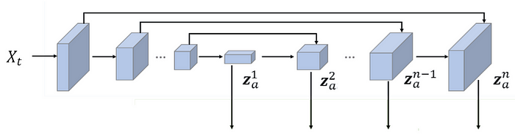
Multi-level Attributes Encoder
This sub-network encodes the target image Xₜ. It produces multiple vectors each one describing the attributes of Xₜ at a different spatial resolution, specifically 8 vectors, called zₐ. Attributes here mean configurations of the face in the target image like the pose of the face, its outline, facial expression, hairstyle, skin color, background, scene lighting, … etc. It is a ConvNet with a U-Net like structure, as can be seen in figure 4, where the output vectors are simply the feature maps of each level in the upscaling/decoding part. Note that this sub-network isn’t pretrained.
19

Slide 21
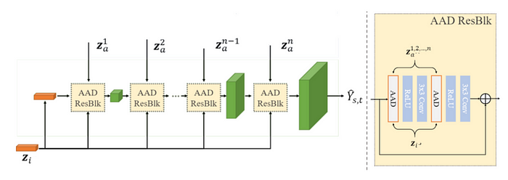
AAD Generator
AAD Generator is an acronym for “Adaptive Attentional Denormalization Generator”. It integrates the outputs of the previous two sub-networks in increasing spatial resolution order to produce the final output of AEI-Net.
20

Slide 22
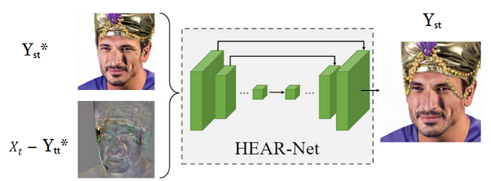
HEAR-Net
The AEI-Net is a complete network than can do face swapping. However, it is not good enough at preserving occlusions. Specifically, whenever there is an item that occludes part of the face in the target image that should be present in the final output (like eyeglasses, a hat, hair, or a hand), AEI-Net removes it. Such items should still persist since it is not related to the identity that is going to be changed. Consequently, the authors implemented an additional network called “Heuristic Error Acknowledging Refinement network” that has a single job of recovering such occlusions.
21

Slide 23
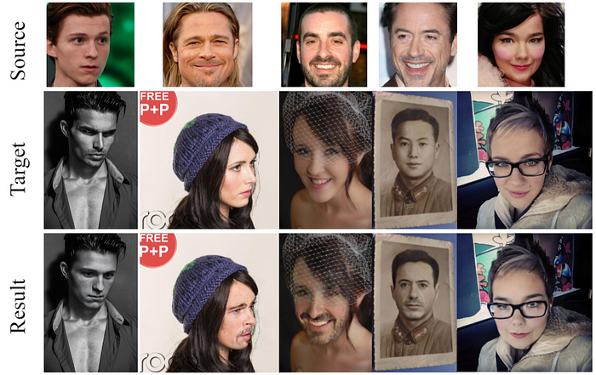
Results
22

Slide 24
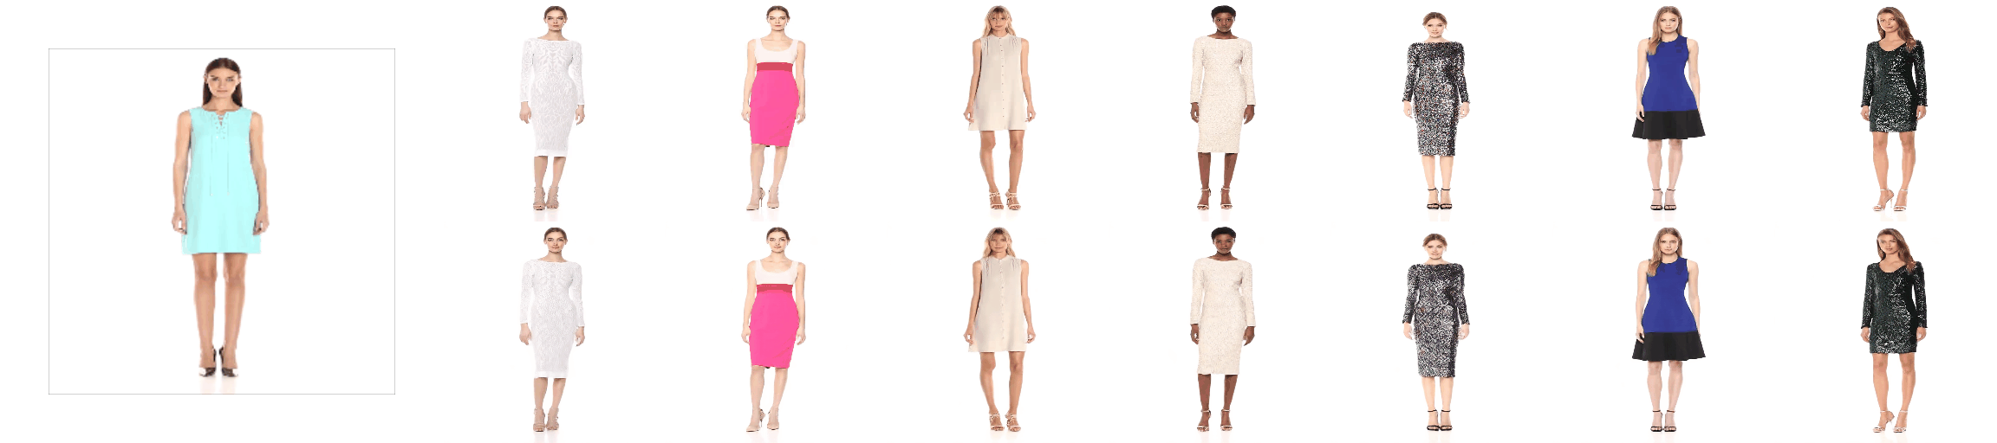
Deepfake using Fashion Dataset
23

Slide 25
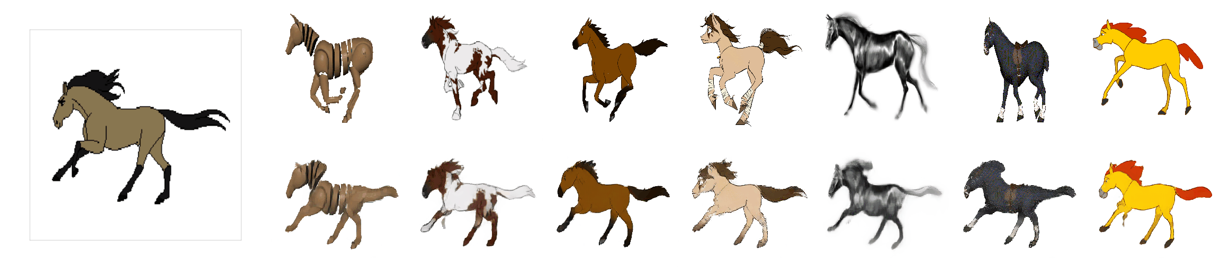
Deepfake using MGIF Dataset
24

